Slide 1
Cloud Management

Slide 2
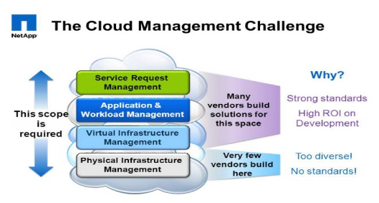

Slide 3
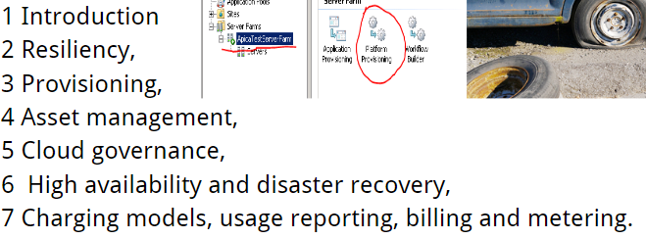

Slide 4
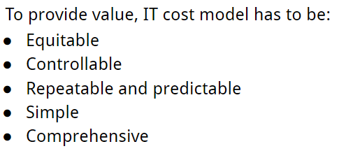
Introduction

Slide 5

1. Service based model

Slide 6
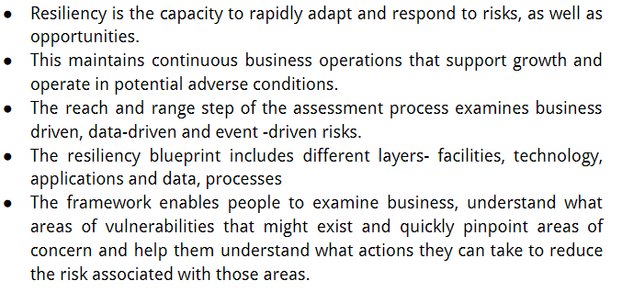
2. Resiliency

Slide 7
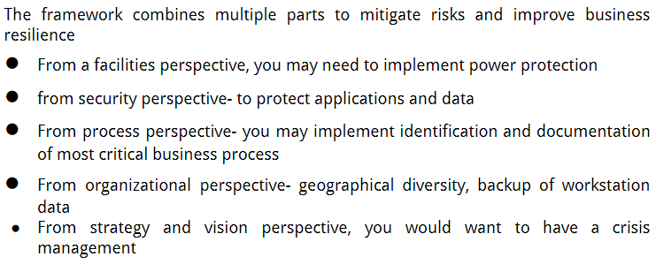
2.1 Resiliency Capabilites

Slide 8
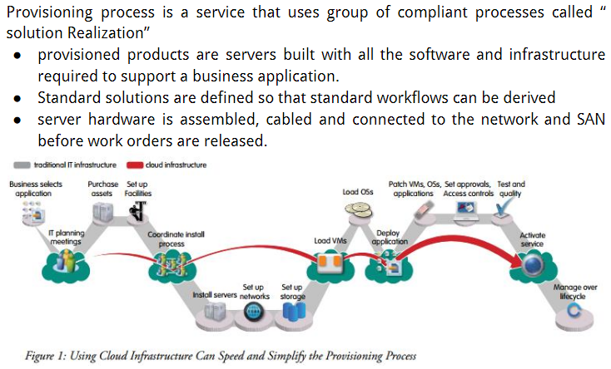
3. Provisioning

Slide 9
Characteristics

Slide 10
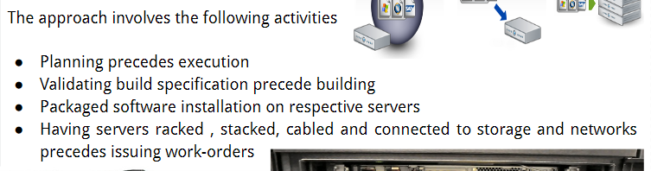
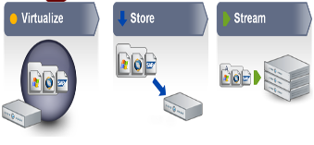
3.1 Approach

Slide 11
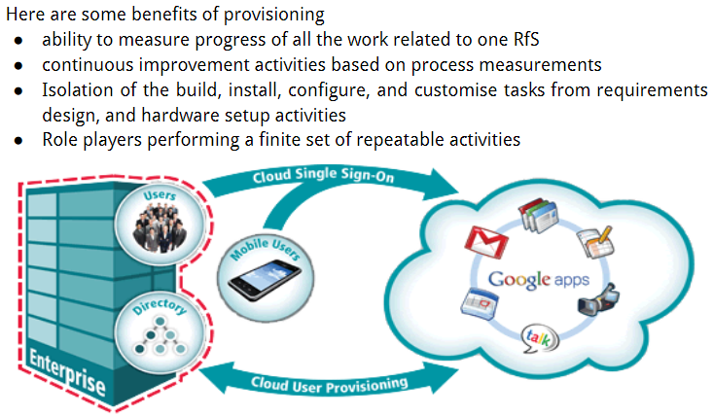
3.2 Benefits

Slide 12
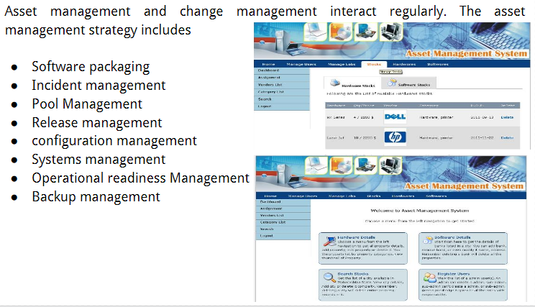
4. Asset Management

Slide 13
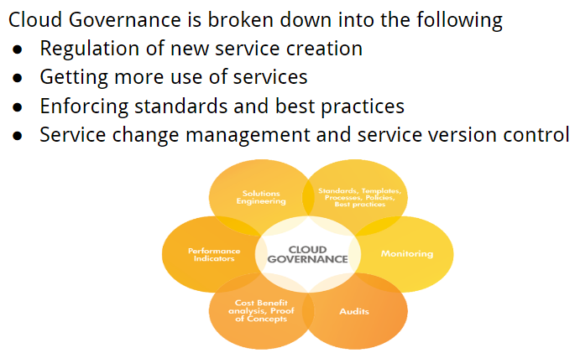
5. Cloud Governance

Slide 14
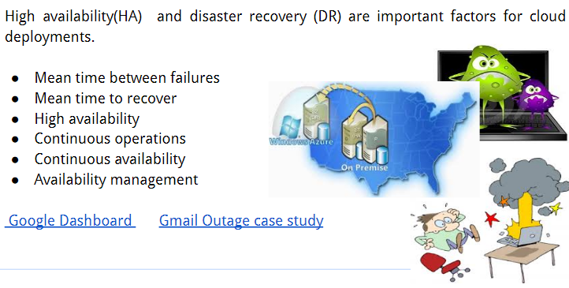
6. High availability and Disaster Recovery

Slide 15
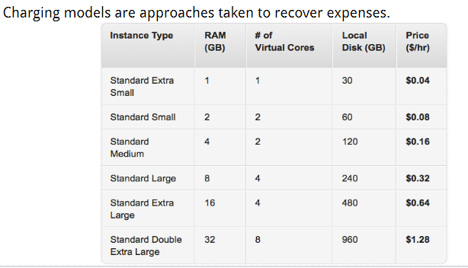
7. Charging models, Usage Reporting, Billing and Metering

Slide 16
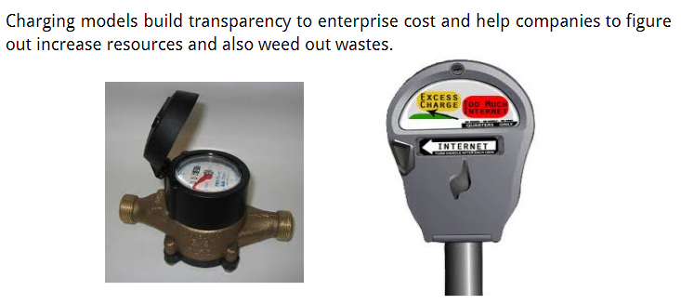
7.1 Benefits

Slide 17
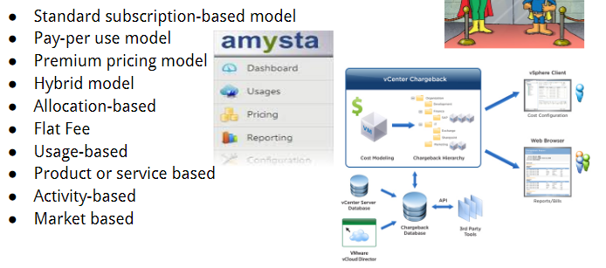
7.2 Cloud Chargeback models

Slide 18
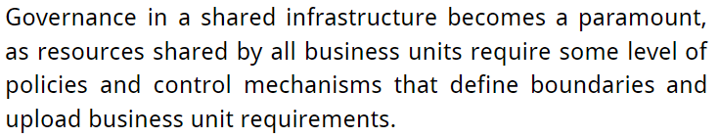
7.3 IT Infrastructure Governance

Slide 19
7.4 Basic Requirements
Fairness
Control
Repeatability
Simplicity

